Slide 1
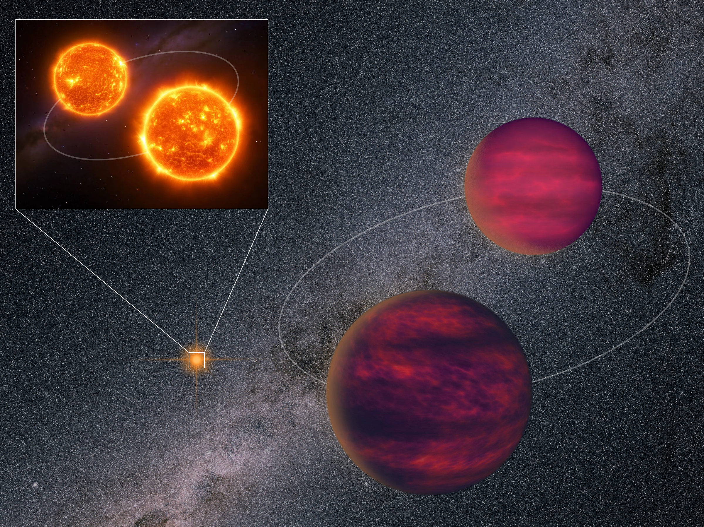
Rare Hierarchical Quadruple System: Pair of Cold Brown Dwarfs Orbiting Pair of Young Red Dwarfs
张曾华(南京大学),
F. Navarete, M. C. Gálvez-Ortiz,
H. R. A. Jones, A. J. Burgasser, P. Cruz,
F. Marocco, N. Lodieu, Y. Shan, B. Gauza,
R. Raddi, M. R. Huang, R. L. Smart, S. Baig,
G. Cheng, and D. J. Pinfield
https://arxiv.org/abs/2505.24560
2025.6.29

Slide 2
Outline
Properties of brown dwarfs (BD)
A [M4+M4] + [T7+T8] quadruple system
Notes:
VVV 1256-62B is a extremely low mass star. Will shine for 10+ trillion years.

Slide 3
Known objects within 10pc
Formation of stars and BDs
Reyle et al. 2021
How many BDs are there in the MW？
1/5
20 M☉
8 M☉
0.5 M☉
0.075 M☉
20%
60%
20%
Star BD
O B A F G K M L T Y
Notes:
https://gruze.org/10pc/resources/
A4,F8,G18,K38,M285,L25,T45,Y19,D21. star/BD=4.2.
There is no young BD within 10 pc.
T dwarfs are the majority, but more difficult to observe than L dwarfs.
有的<400K低温天体可能没被发现，亮星周围可能有没探测到的伴星。

Slide 4
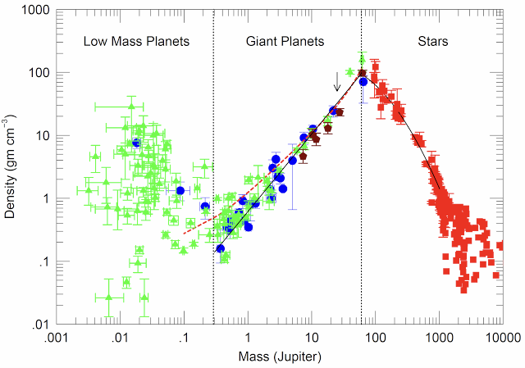
Radius, mass, density, temperature of low mass objects
BD
Hatzes & Rauer 2015
Notes:
Known BDs have mass between 3-80 Mjup, all have radius similar to that of Jupiter.

Slide 5
Atmospheres of Jupiter/Y, T, L and late-M dwarfs
dusty
dusty
Y dwarfs
Lodders & Fegley 2006

Slide 6
BDs are formed like stars, look like giant planets
H + Ks + L’
The last major populations on the HRD.
Sensitive to initial mass function.
Test stellar/substellar formation theories.
Help to characterize exoplanets.
As exoplanet hosts.
25 M_{Jup}
5 M_{Jup}
First image of an “exoplanet” (Chauvin et al. 2004)
Notes:
I would like to emphasize the importance of BDs, before I move to metal-poor BDs.
One of the first motivations is for dark matter candidate? (No!)
Star/BD fraction is around 5, there are still a lot faint BDs nearby we have not observed.

Slide 7
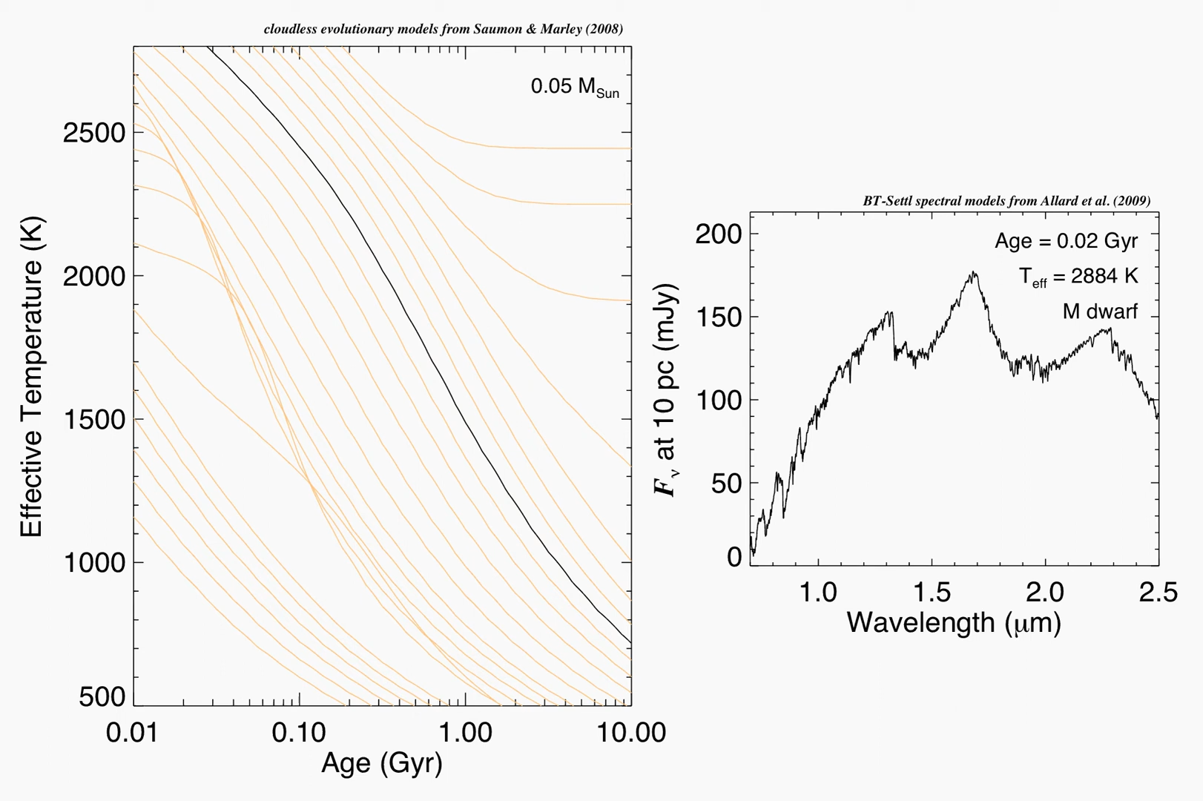
Teff and spectral evolution of BDs

Slide 8
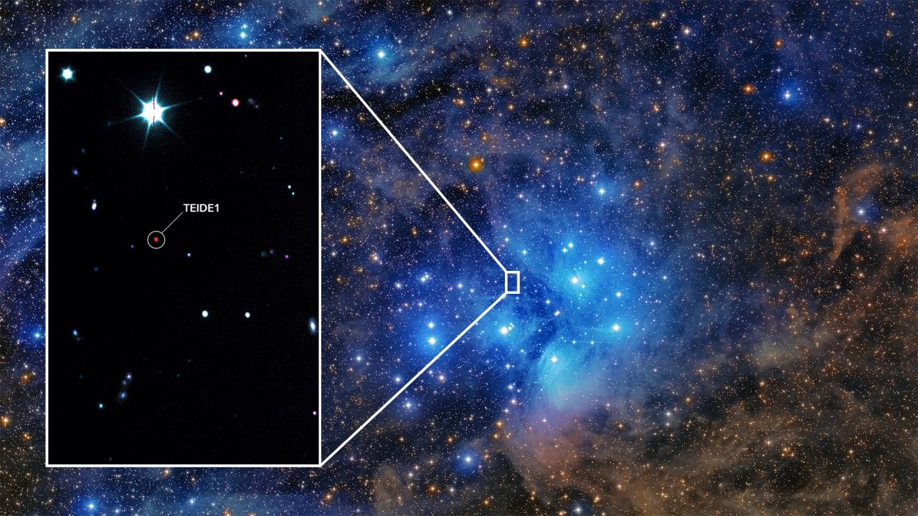
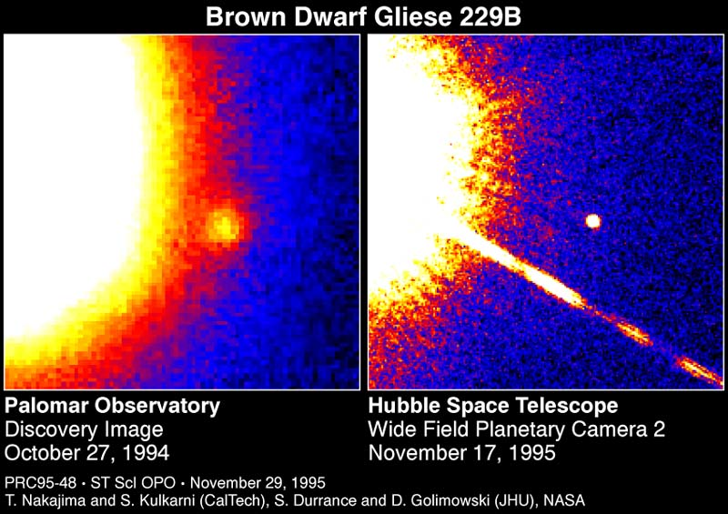
What are benchmark brown dwarfs?
Nakajima et al. (1995)
Rebolo, Zapatero Osorio & Martin (1995)
Notes:
Open clusters have young age, and further away. M dwarf primary have larger error of age and metallicity constraint, can provide precise distances. FGK for metallcity, WD for age. Binary brown dwarfs for dynamical mass.

Slide 9
GL 229 B is a close binary
Xuan et al., 2024, Nature
M1+[T7+T8]
Notes:
M4 + T6+T9

Slide 10
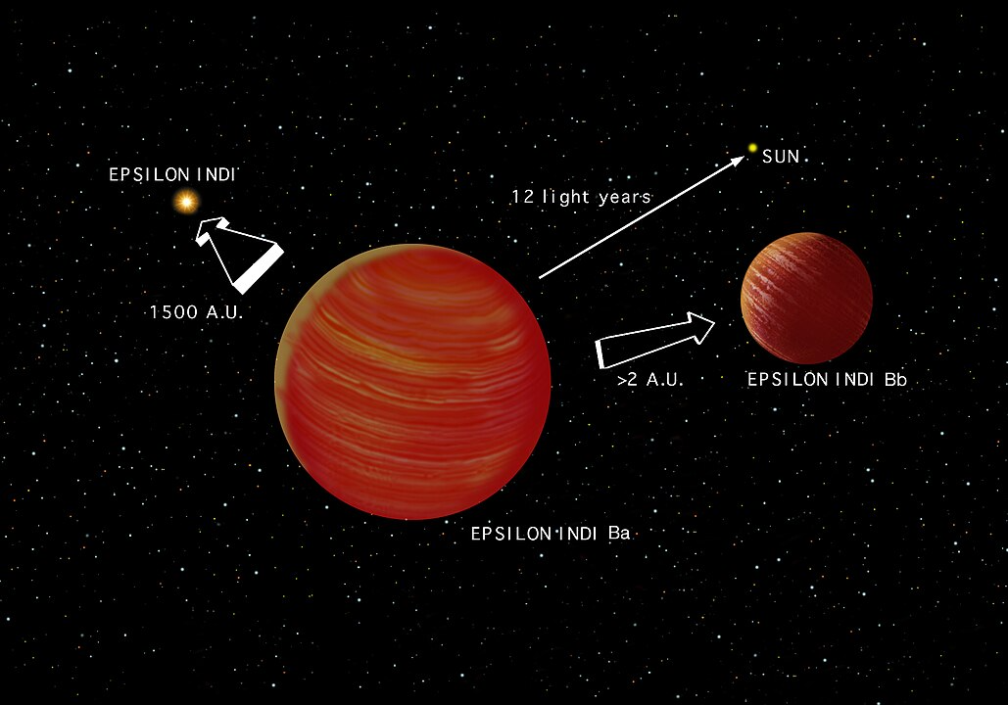
K5+[T1+T6]

Slide 11
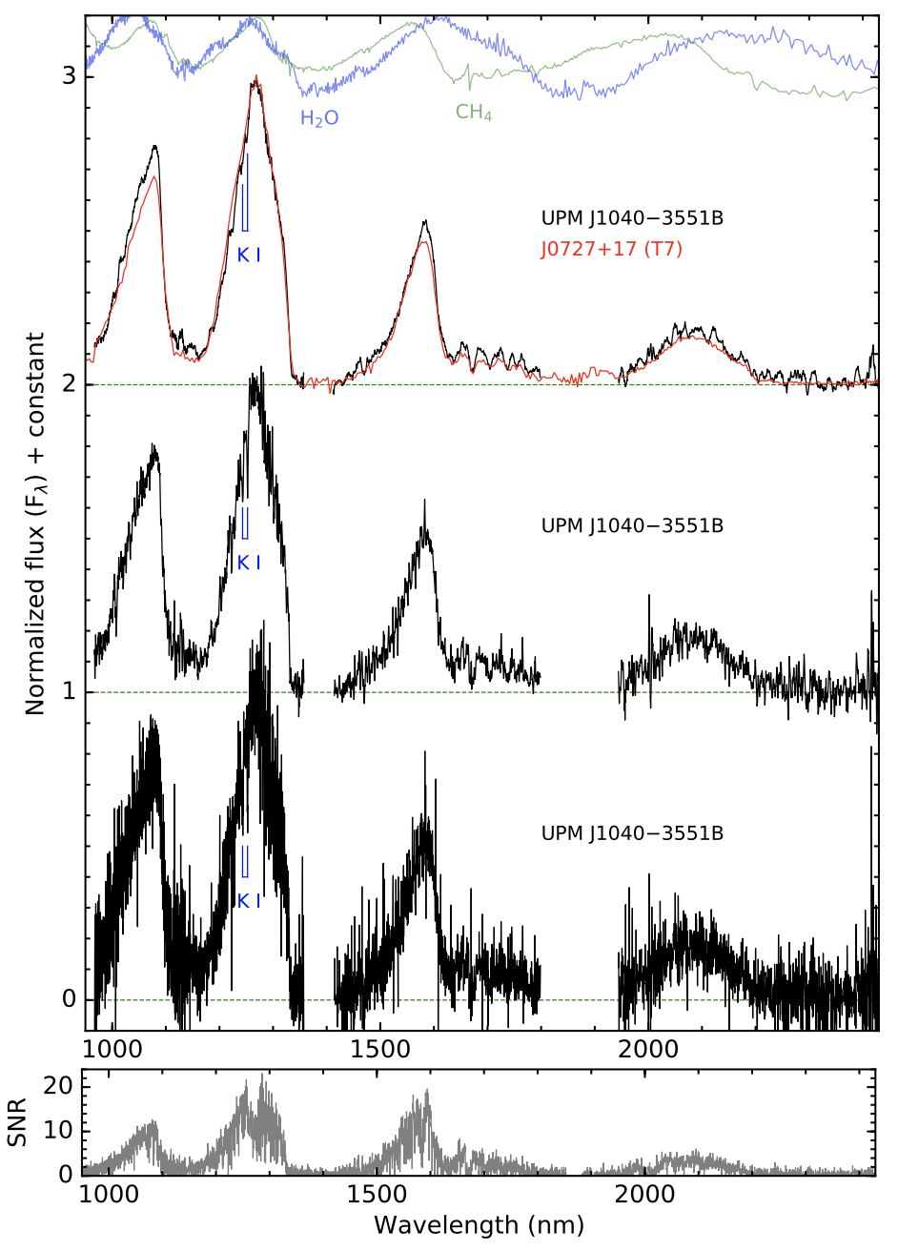
UPM J1040-3551 A & B
0.3-2 Gyr
3200 K

Slide 12
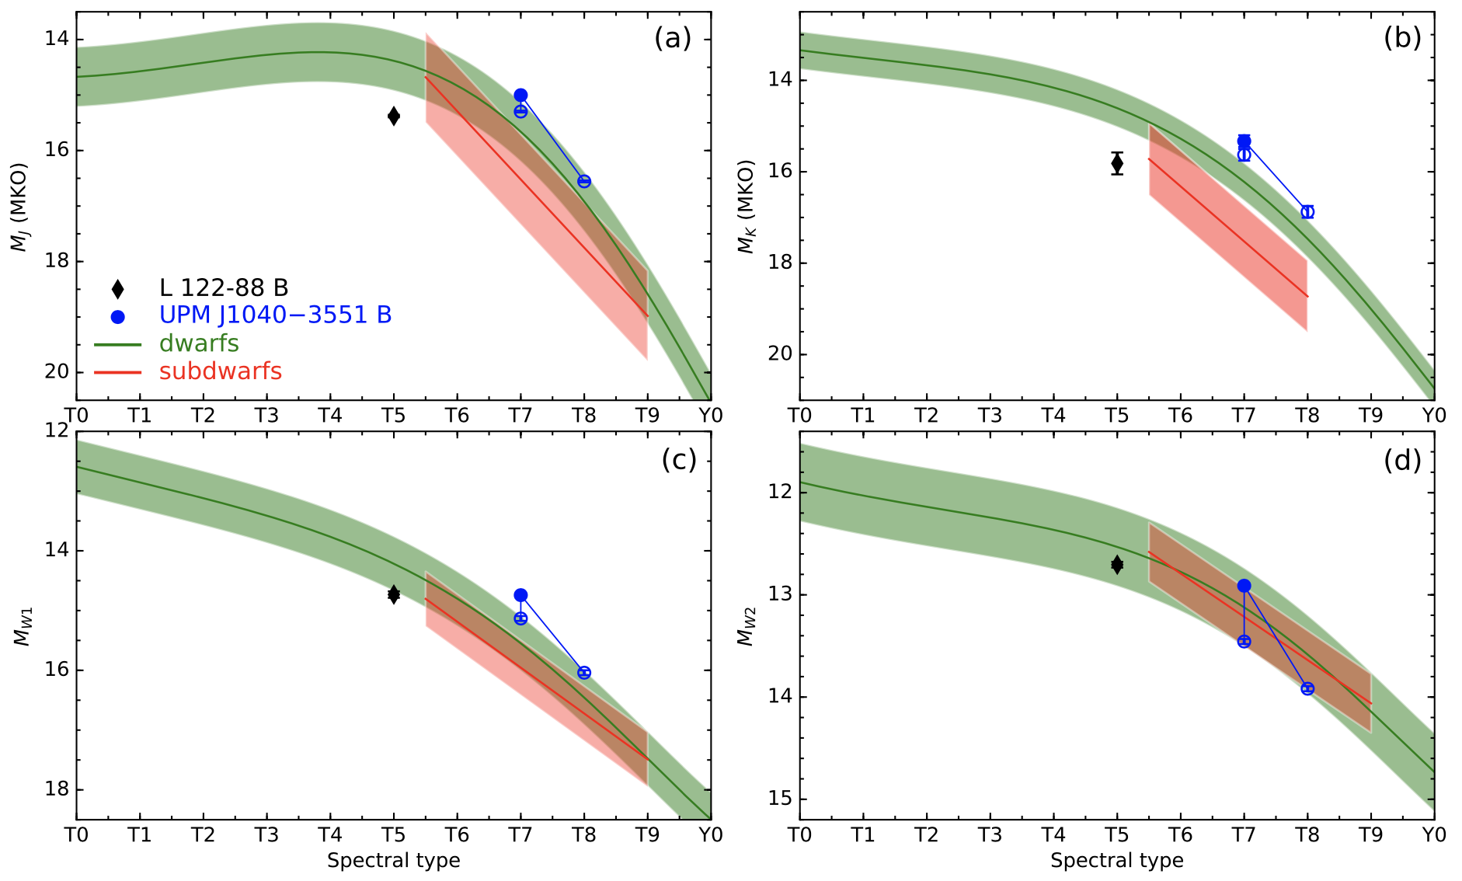
Over luminosity due to binarity

Slide 13
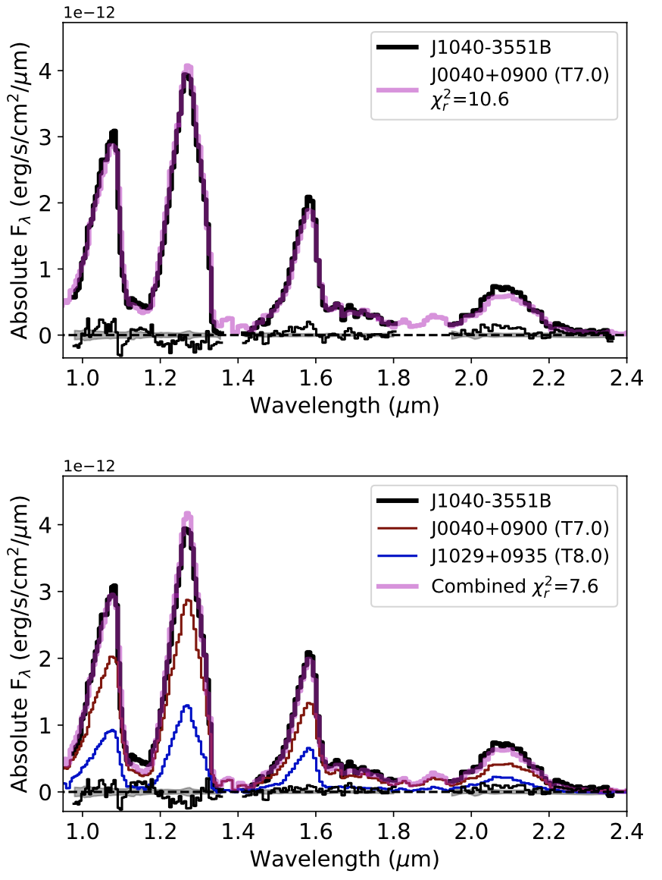
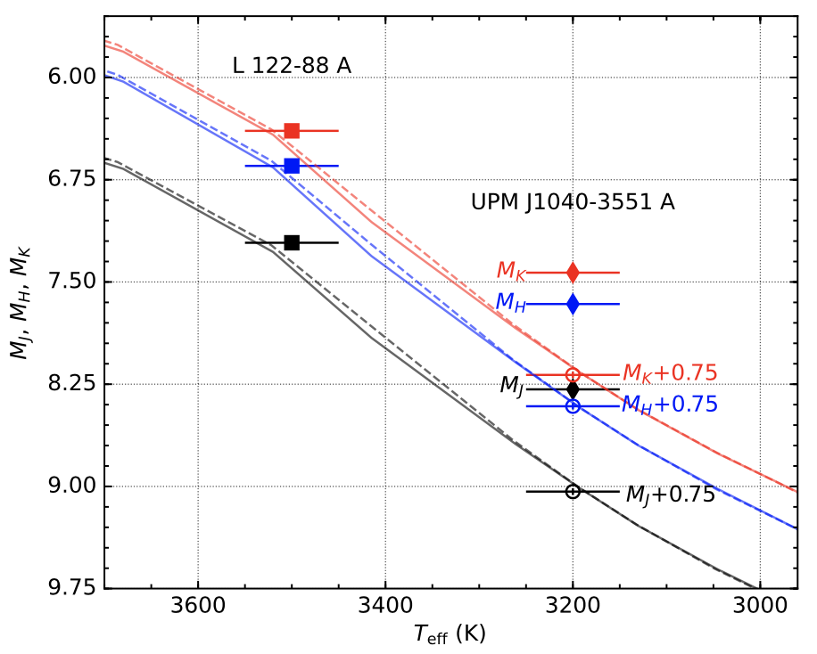
[M4+M4] + [T6+T9] hierarchical quadruple
T7
RUWE = 1.32
RUWE = 1.47
T7+T8

Slide 14
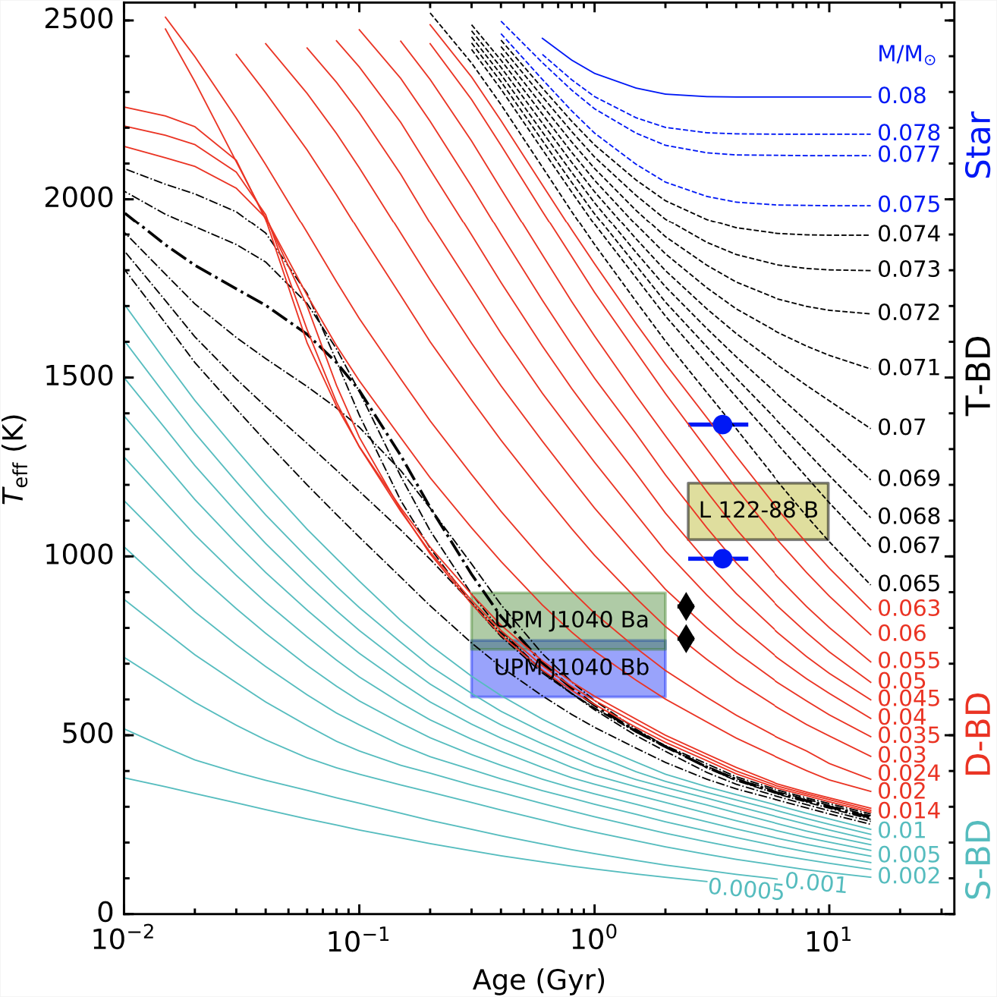
UPM J1040-3551 Bb is a potential planetary mass object
13 M_{Jup}

Slide 15
M4: 0.174 M☉
M4: 0.165 M☉
Ab
Aa
Ba
T7: 12-35 M_{Jup}
T8: 9-28 M_{Jup}
Aab
Bb
25 pc
1565 au
Notes:
Aab < 50 yr, Bab < 160 yr. AB> 10万年。

Slide 16
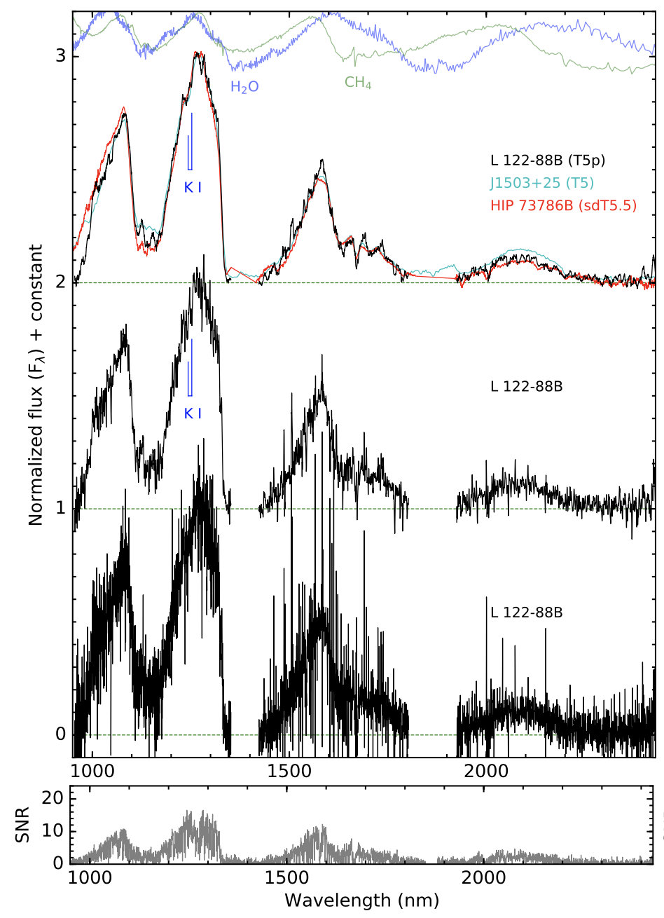
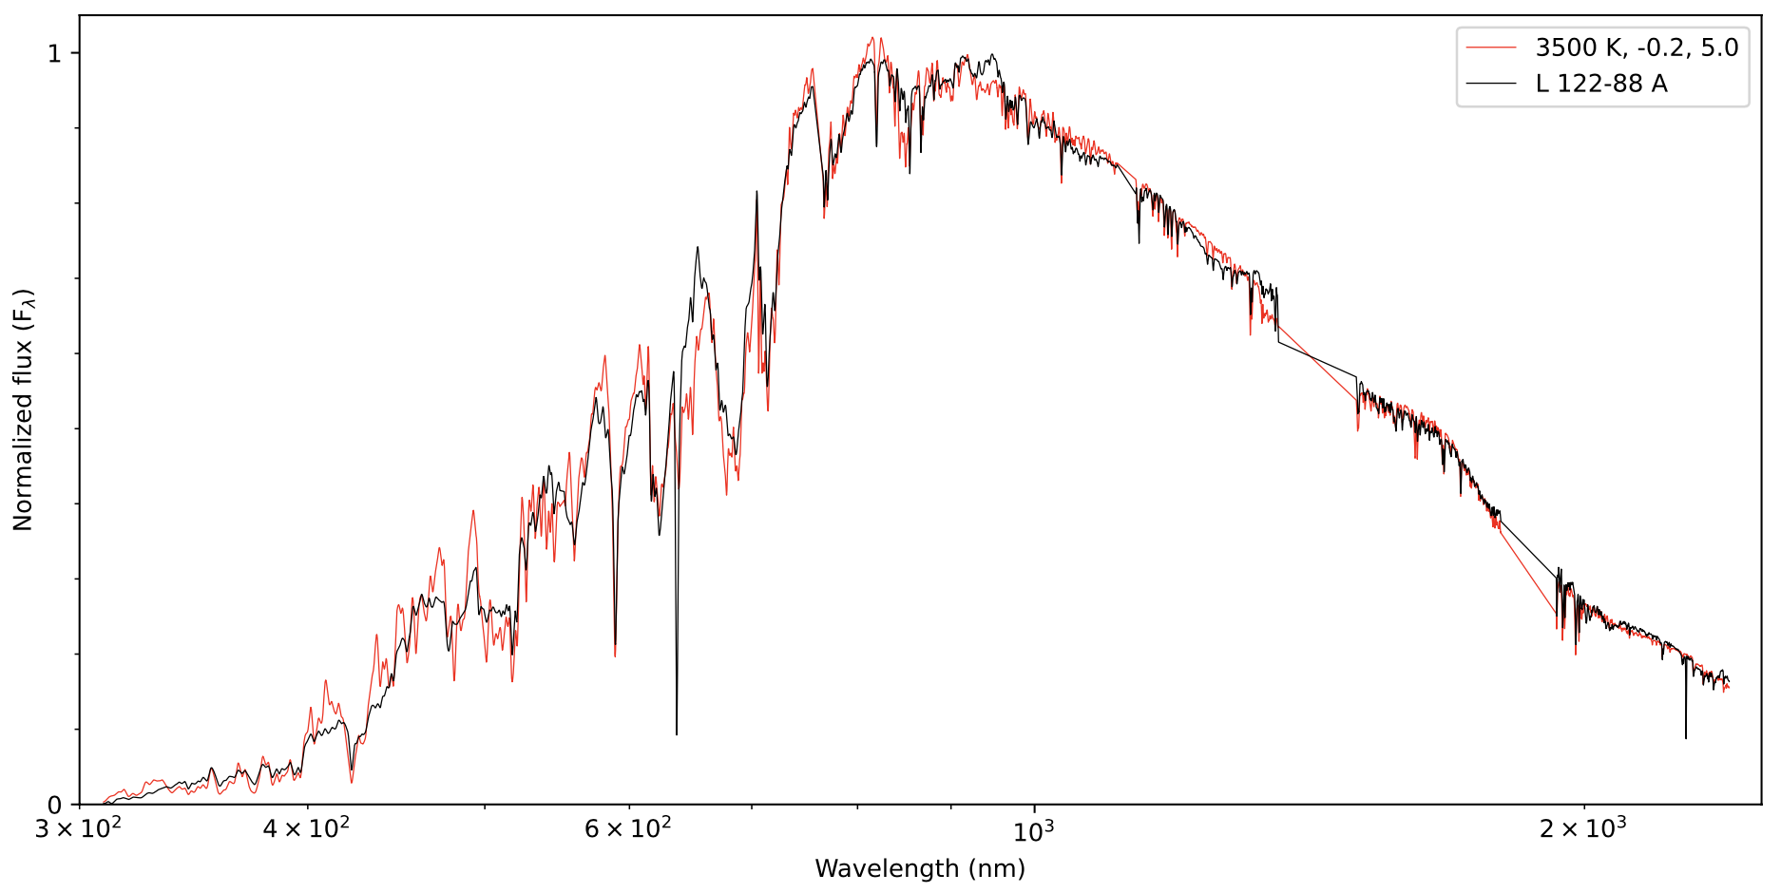
A mildly metal-poor M2 + T5 wide binary

Slide 17
« Benchmark brown dwarfs » series
A blue M2 + T5 wide binary and a probable [M4 + M4] + [T6 + T9] hierarchical quadruple https://arxiv.org/abs/2505.24560
Discovery of three wide binaries of M and L dwarfs in Gaia and Pan-STARRS
46 L dwarf wide binaries with spectroscopic follow ups from GTC, VLT, Keck, SOAR.

Slide 18
Rare Hierarchical Quadruple System: Pair of Cold Brown Dwarfs Orbiting Pair of Young Red Dwarfs
张曾华(南京大学),
F. Navarete, M. C. Gálvez-Ortiz,
H. R. A. Jones, A. J. Burgasser, P. Cruz,
F. Marocco, N. Lodieu, Y. Shan, B. Gauza,
R. Raddi, M. R. Huang, R. L. Smart, S. Baig,
G. Cheng, and D. J. Pinfield
https://arxiv.org/abs/2505.24560
2025.6.29

Slide 19
The first L extreme subdwarf in wide binary (esdM1+esdL0)
Zhang (2019)
Notes:
Not a BD. Observed B with JWST NIRSpec, and observed A&B with X-shooter.

Slide 20
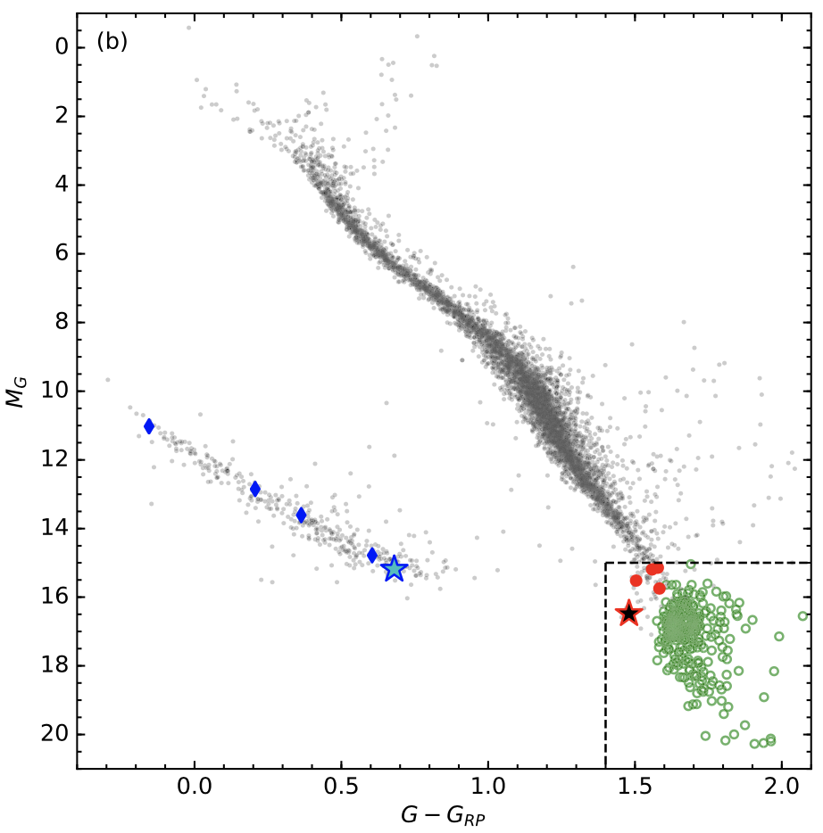
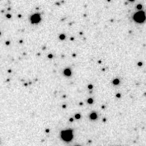
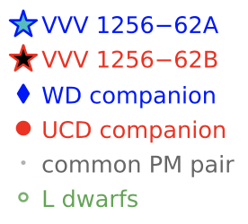
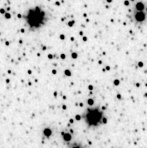
The first halo WD + L subdwarf wide binary VVV 1256-62 AB
Zhang et al. (2024)

Slide 21
The L3 subdwarf companion (0.082M☉, 2290K, [Fe/H] = -0.81)
The DC WD companion (0.62M☉, 4440K, 10.5+3.3/-2.1 Gyr)
Notes:
10.5Gyr 的年龄相对其10Tyr的寿命来说，B 还是个刚满月的婴儿。JWST target

Slide 22
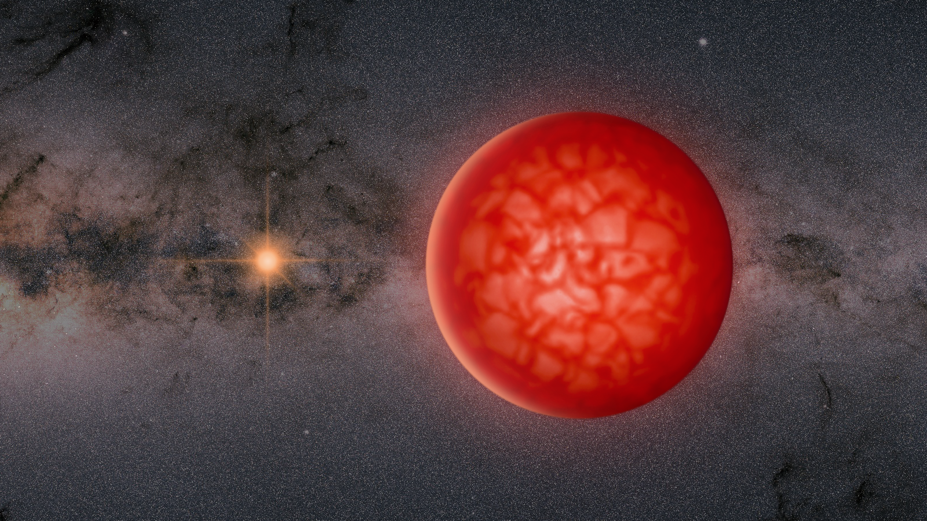
Artist’s conception of VVV 1256-62 AB
Notes:
It spent 10 Gyr to reached radiative equilibrium. It is a baby star compared to its 10+ Tyr lifetime.
VVV 1256-62B is a extremely low mass star. Will shine for 10+ trillion years.

Slide 23
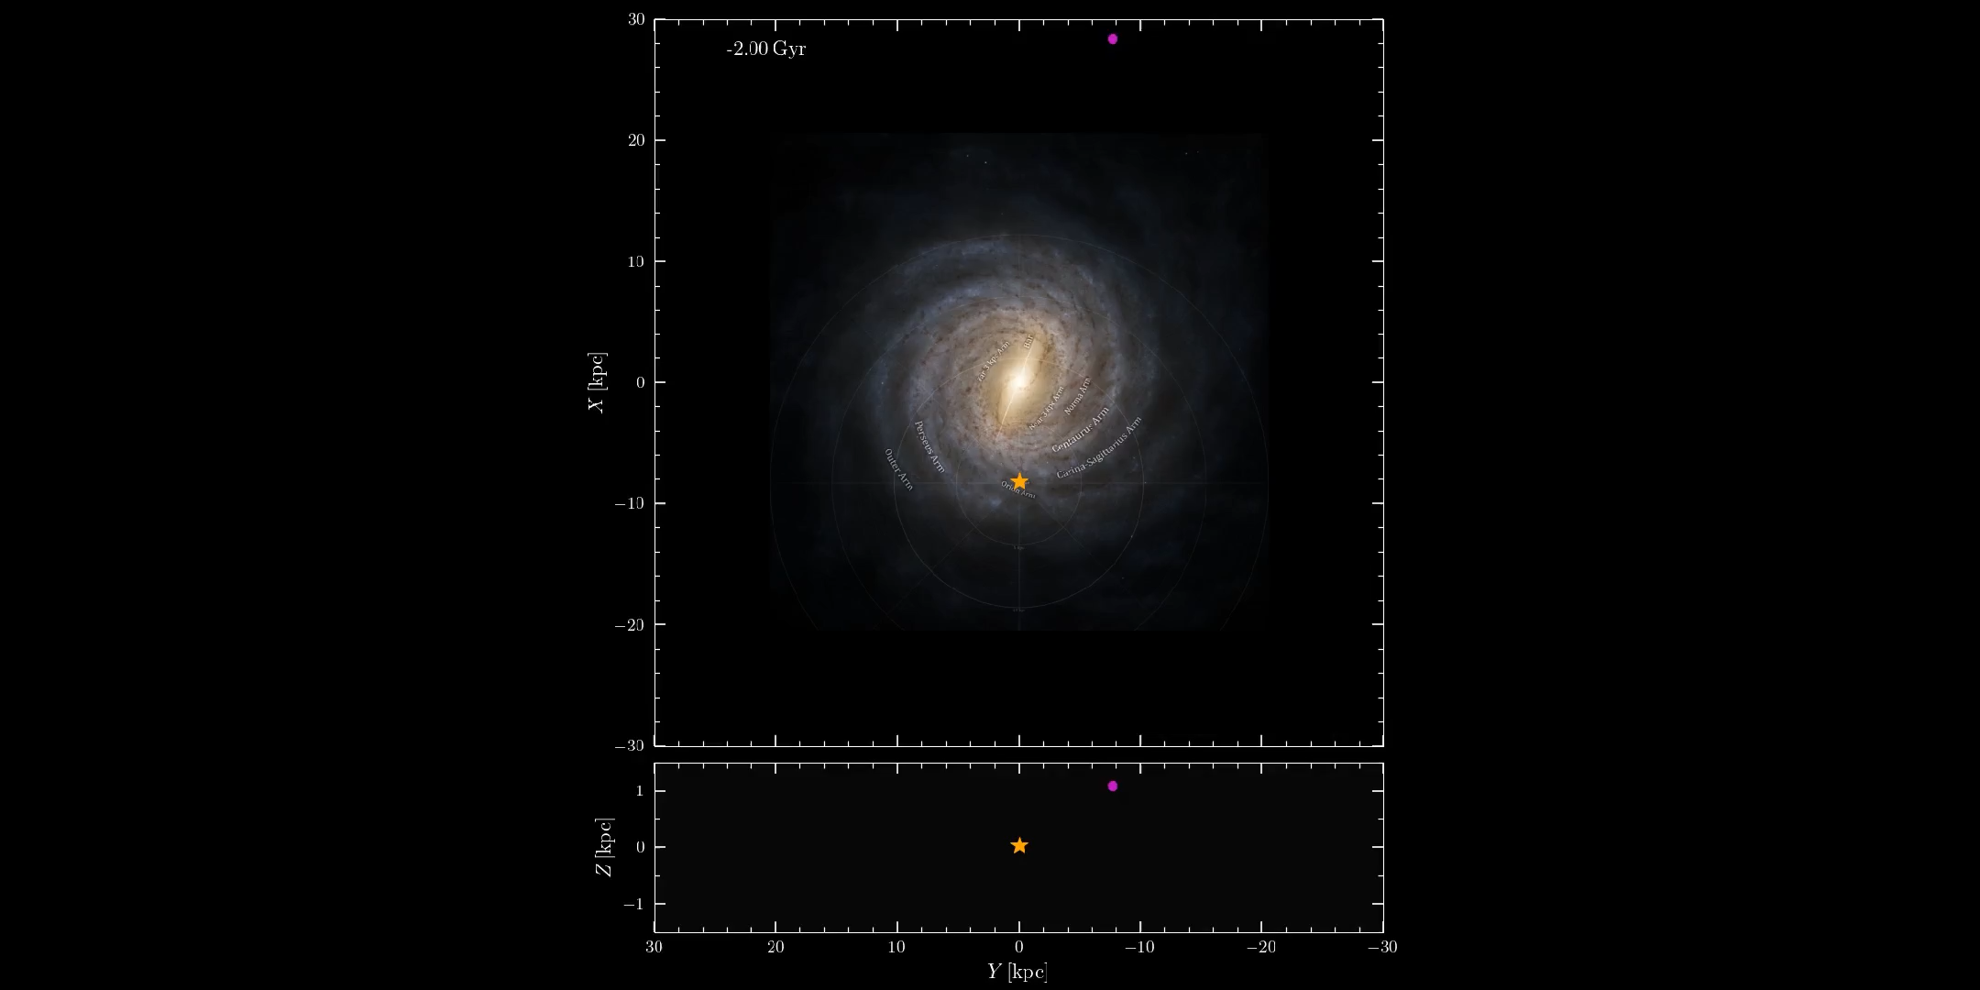
The face-on (upper) and
edge-on (lower) views
of the Galactic orbit of
VVV 1256−62AB (purple dot)
from the past 2 Gyr (cyan curves)
to the future 2 Gyr (red curves).
Its current location is near
the Sun which is indicated by
a five-pointed star.
VVV 1256-62 AB
从过去20亿年（青色）到
未来20亿年（红色）之间
在银河系内的轨道的
俯视图（上）和侧视图（下）
五角星是太阳当前的位置

Slide 24
Primeval series
Notes:
Vtotal = 406

